Slide 1
Automating tedious tasks with Expect
Steve Wainstead
spawlowski@diligent.com
Sept 19, 2019

Slide 2
What we will cover
What is Expect? How can it help you, the developer or engineer?
A very, very, VERY brief intro to the tcl scripting language
Examples of Expect in my daily work
Some more complex solutions I wrote in past roles
Wrap up

Slide 3
How can I automate more tasks during my work?

Slide 4
How can I automate more tasks during my work?
kubectl
docker
docker-compose
mysql
bash
git
curl
code

Slide 5
First demo: logging into a pod

Slide 6


Slide 7
Here are your program requirements, part 1:
Write a program that monitors a modem, answers calls, and depending on the caller either:
Receives a zmodem file, or
Sends a login prompt

Slide 8
Here are your program requirements, part 2:
Write a program that connects to a load balancer and:
Waits for a string ”Incorrect VIPs” to appear, and if so, issue commands to fix the problem; or
Switch to an interactive prompt and lets the user take over
Then lets the user return control to the script

Slide 9
Here are your program requirements, part 3:
The year is 1998, and converting songs to mp3 is slow, and so is uploading them over a modem. Do all three in parallel to save time:
Convert track to WAV file
Convert WAV file to mp3
FTP the mp3 to a server

Slide 10
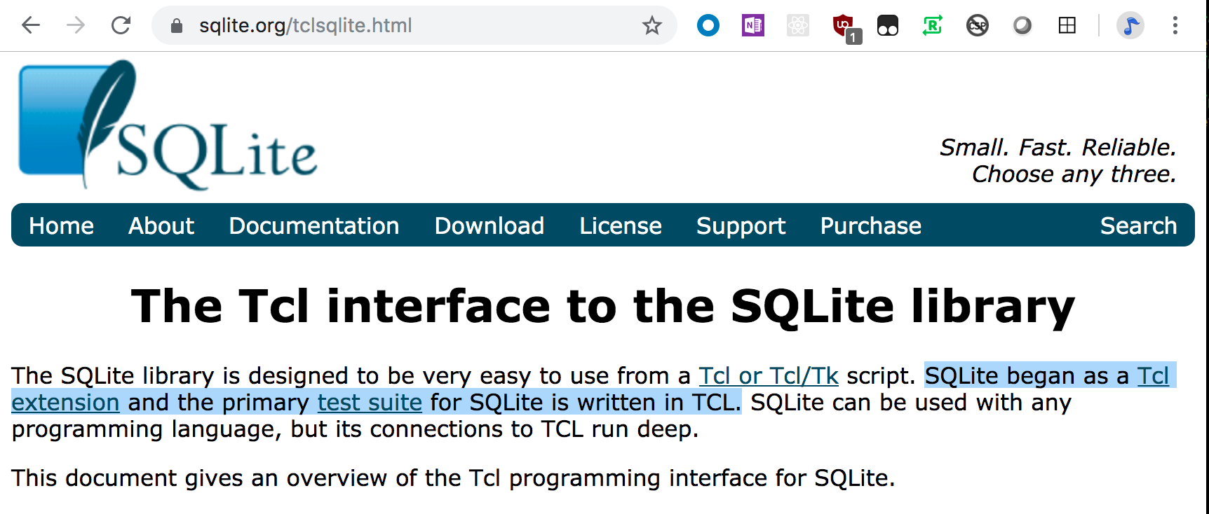

Slide 11
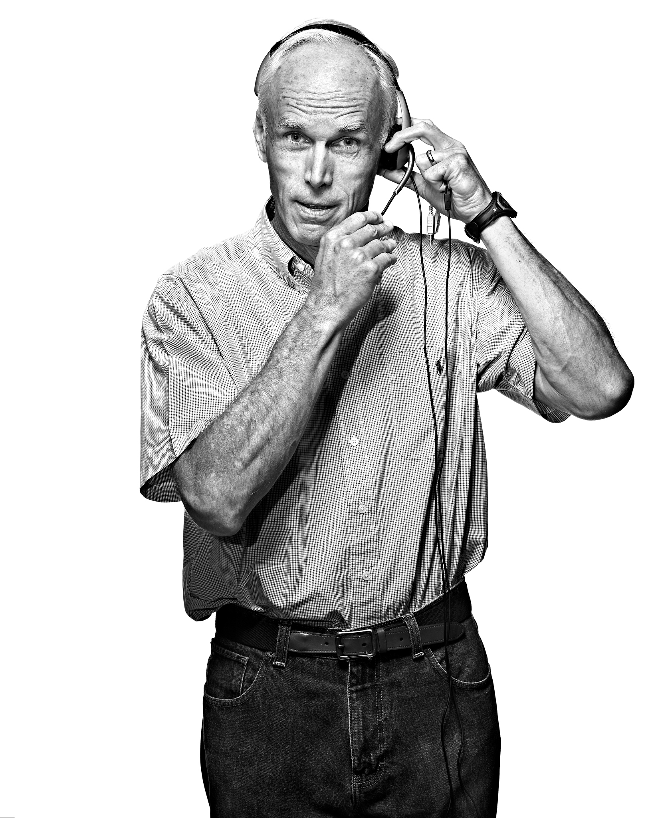

Slide 12
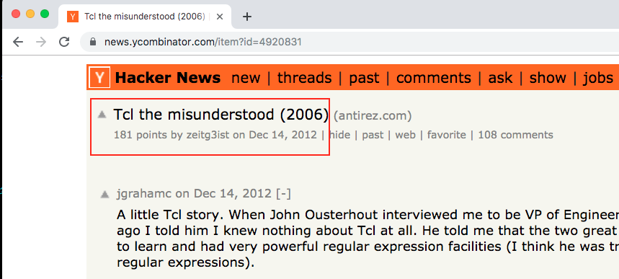
Tcl the Misunderstood

Slide 13
Tcl the Misunderstood
“I have no doubt, that there is no language that is as misunderstood in the programming community as Tcl is.”

Slide 14
Everything in Tcl is a command.
set a 5 ;# never a = 5!
puts $a
# There are no ”language constructs” per se,
# only commands. Even if, while, and for
# are commands.
if {} {}
while {} {}
for {} {} {} {}

Slide 15
In tcl, everything is a string – no types
set a pu
set b ts
$a$b "Hello World”
“Yes, in Tcl everything happens at runtime and is dynamic: it's the ultimate late binding programming language, and there are no types.”
-- “Tcl the Misunderstood”

Slide 16
Substitition
# Command substitution:
set a 5
puts [set a] ;# outputs “5”
# Variable substitution
set a 5
puts $a ;# outputs “5”

Slide 17
Demo 1, revisited
How to write a simple chat script with “expect”
How to transition to “interact”

Slide 18
Demo 1, improved
How to write a simple chat script with “expect”
How to transition to “interact”
How to write your own command subsystem!

Slide 19
Demo 2: tailing a log file in a container running MariaDB

Slide 20
Example 1: comm.exp
Write a program that monitors a modem, answers calls, and depending on the caller either:
Receives a zmodem file, or
Sends a login prompt

Slide 21
Example 2: fix-alteon.exp
Write a program that connects to a load balancer and:
Waits for a string ”Incorrect VIPs” to appear, and if so, issue commands to fix the problem; or
Switch to an interactive prompt and lets the user take over
Then lets the user return control to the script

Slide 22
Example 3: ripsend
The year is 1998, and converting songs to mp3 is slow, and so is uploading them over a modem. Do all three in parallel to save time:
Convert track to WAV file
Convert WAV file to mp3
FTP the mp3 to a server

Slide 23
D. Richard Hipp
Author of SQLite
Lives in Charlotte!
Here, holding a pie for the 3.14 release of SQLite (get it? Pi?)

Slide 24
More information, resources
”Exploring Expect,” Don Libes. Can be had for cheap ($1.61 used, plus shipping)
StackOverflow. Lots of good solutions
Tcl the Misunderstood: http://antirez.com/articoli/tclmisunderstood.html
Web site: tcl.tk: https://www.tcl.tk/doc/
Sqlite and Tcl: https://www.sqlite.org/tclsqlite.html
D. Richard Hipp tweet photo: https://twitter.com/planetsqlite/status/773058278288986112
John Ousterhout: http://www.facesofopensource.com/john-ousterhout/

Slide 25
What we covered
Expect is a tool that can automate interactive tasks, via scripting
Tcl is a very simple, yet misunderstood, language
Using Expect for common work at Diligent
You can solve problems you never thought you could easily solve before

